Slide 1
Ensuring Housing Stability: Considerations on Strengthening Tenants Rights
Nada Hussein, NLIHC
May 8, 2024

Slide 2
NLIHC’s State and Local Innovation Project
Our work is to support state and local partners in advocating for housing innovations that seek to keep eviction rates down and prevent homelessness. Our work focuses on three main areas:
Advancing, implementing, and enforcing state and local tenant protections
Creating and sustaining permanent emergency rental assistance programs
Preventing the criminalization of homelessness

Slide 3
Our Goal is to…

Slide 4
NLIHC’s ERASE Project
NLIHC’s End Rental Arrears to Stop Evictions Project ran from January 2021 to December 2023
We worked at the federal, state, and local levels to ensure ERA funds were disbursed equitably and efficiently
ERA → Tenant Protections

Slide 5
States with new protections since January 2021

Slide 6
Examples of Tenant Protections
Prevents Discrimination
Seal/expunge eviction records
Protects the Right to Organize
Fund organizing efforts
Eliminate application and junk fees
Source-of-income protections
Right to accessible housing enforcement
Promote tenant unions
Regulate tenant screening practices
Upholds a Fair and Transparent Application Process
Right to live free of harassment or retaliation
Prohibit unreasonable lease terms
Rent stabilization and anti-rent gouging
Habitability standards
Just cause standards
Guarantees Rights During Tenancy
Eviction as Last Resort
Relocation and housing navigation services
Notice requirements and filing fees
Increase funding for legal assistance
Right to counsel
Emergency rental assistance
Language accessible leases

Slide 7
Trends in Tenant Protections Passed Since 2021
Momentum for tenant protections is growing!
Prior to the pandemic, only 7 cities had implemented right-to-counsel protections, today 17 cities, four states, and 1 county have implemented such protections
Prior to the pandemic, 16 states had implemented source-of-income protections, today, 21 states have

Slide 8
2024 Legislative Sessions
8 states have introduced eviction record sealing and expungement legislation
8 states have introduced “just cause” eviction protections
4 states have introduced legislation targeting stronger habitability standards
5 states have introduced legislation to require longer notice-periods for eviction proceedings
4 states have introduced legislation to create landlord-tenant mediation programs
5 states have introduced right to counsel legislation
6 states have introduced legislation to limit rental “junk” fees
2 states have introduced legislation to repeal rent control preemptions

Slide 9
Common Challenges Encountered
Lack of political will
Insufficient resources/underfunded programs
Lack of enforcement of tenant protections
Opposition from landlord groups to support tenant protection bills
State-level preemptions

Slide 10
Support Needed
Building the evidence base around the impact of tenant protections
Accessing, analyzing, and understanding eviction data
Advocacy strategies that can be employed
Insight on educating state and local elected officials
Coalition building
Implementation support
Social media support/bringing awareness to tenant protection campaigns

Slide 11
Tenant Protections Work!
A relocation assistance ordinance passed in Seattle helped to indirectly keep rental rates under 10% across the city
In New York, 84% of tenants represented by the city’s right to counsel program remained in their homes
During the COVID-19 pandemic, the eviction moratorium helped to prevent as many as 1.66 million evictions
Higher eviction filing fees dissuade landlords from filing for eviction against tenants
In states where there are anti-retaliation protections, there was a 14.6% reduction in eviction judgements against tenants between 2001 and 2018

Slide 12
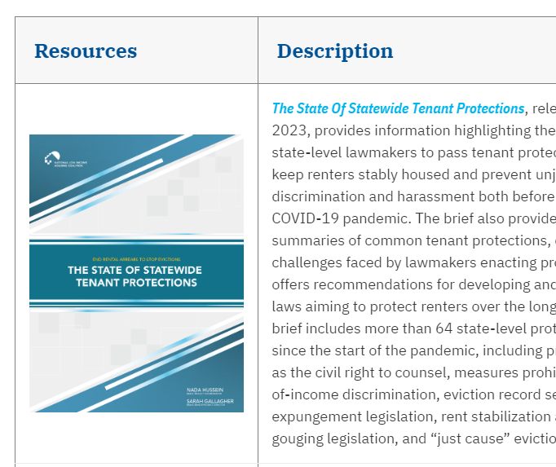
Resources

Slide 13
Questions?
Please reach out to Nada Hussein at nhussein@nlihc.org

