Slide 1

NLIHC Federal Updates
AAHC Membership Meeting 11/4
Kenza Idrissi Janati
Housing Advocacy Coordinator
National Low Income Housing Coalition

Slide 2
Today’s Outline
Intro to NLIHC
Federal Policy Updates
  Take Action!
Other Ways to Engage
Connect with NLIHC

Slide 3
NLIHC Mission
The National Low Income Housing Coalition is dedicated to achieving racially and socially equitable public policy that ensures people with the lowest incomes have quality homes that are affordable and accessible in communities of their choice.

Slide 4
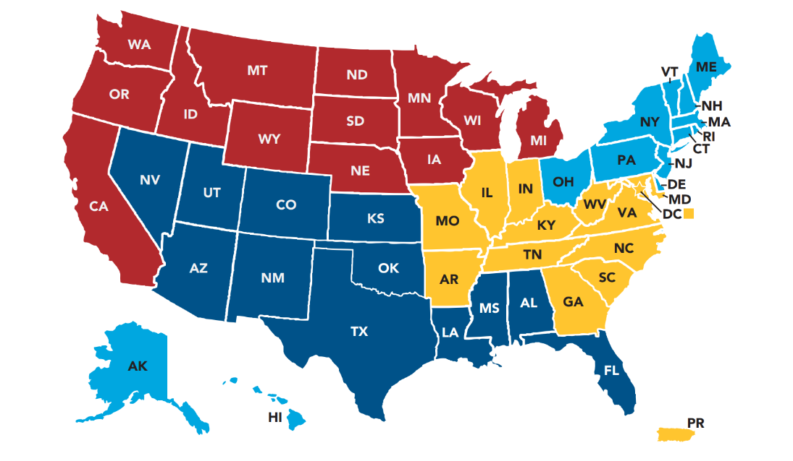
NLIHC NM Network
Albuquerque Affordable Housing Coalition
Albuquerque Health Care for the Homeless
Cuidandos Los Niños, Inc
New Mexico Coalition to End Homelessness
5 Total Individuals, LI Individuals, Students & Resident/Tenant/Student Associations
Let's Build Together!
​
​
Notes:
Broad-tent coalition of members across the country
We have about 4 organizational members and about 5 total individual members – let's build!
My role as an organizer in the dark blue region (managing relationships across the region – happy to connect people)

Slide 5

Federal Policy Updates
What's going on?

Slide 6
Forecasting November-December
Congress currently in recess until November 9th
  Before adjourning, Congress passed a continuing resolution (CR) through December 11
    CR included a temporary block of the OMB proposed rule, “Regulation for Federal Financial Assistance"
    CR included language clarifying PHAs can use funding for the Tenant Protection Voucher (TPV) account to transfer Emergency Housing Voucher (EHV) holders to new assistance
Congress will be in session for just five weeks (until December 17/18) for the remainder of the 119th Congress
  End-of-Congress priorities will largely depend on the outcome of November elections
Notes:
Kick the can down the road until the next Congress (march/april)
Another possibility (a year-long CR)
Hoping for a CR that will:
Perm block the OMB rule
Congress to include language to continue/extend CoC grants

Slide 7
Top NLIHC Priorities Right Now
Finalize FY27 spending bill for HUD programs with increased funding for rental and homelessness assistance, and language to ensure funding reaches communities as intended by Congress
  Sufficient funding to ensure full voucher renewals, and language protecting the CoC program from changes that would destabilize 97,000 people previously experiencing homelessness
Pass a disaster supplemental bill with funding for the CDBG-DR program
Permanently block the implementation of the OMB NPRM, “Guidance for Federal Financial Assistance”
Protect Congressionally-appropriated funding from being rescinded, frozen, or otherwise withheld from communities by the executive branch
Notes:
Disaster supplemental spending bill: can be stand-alone or can be attached to CR (OR THROUGH NDAA)

Slide 8
21st Century Road to Housing Act
It Passed! But What Now?
Now we look towards implementation of these key priorities:
  Reforming Disaster Recovery Act – CDBG-DR funding formula, Congressional appropriations (via disaster supplemental and subsequent appropriations bills)
  Rural Housing Service Reform Act
  Provisions of Choice in Affordable Housing Act
  Implementation of RAD and MTW expansion – ensure tenant rights are recognized and upheld
Discussion among Congressional Democrats about pursuing another housing bill (ROAD 2.0?)

Slide 9
Two Priority Bills Reintroduced
Family Stability and Opportunity Vouchers Act – co-sponsored by Sens. Todd Young (R-IN) and Chris Van Hollen (D-MD), Reps. Joe Neguse (D-CO) and Brian Fitzpatrick (R-PA)
  Authorizes 250,000 new Housing Choice Vouchers plus housing counseling services for families with children younger than six years old
Eviction Crisis Act – co-sponsored by Sens. Todd Young (R-IN) and Michael Bennett (D-CO)
  Creates a permanent Emergency Rental Assistance (ERA) program funded at $3 billion for people at risk of losing their housing because of an emergency expense
  Funds eviction diversion and data collection to better understand the prevalence and impact of eviction

Slide 10
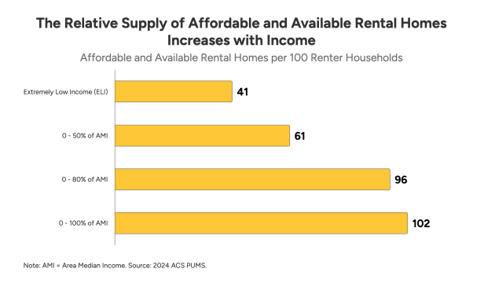
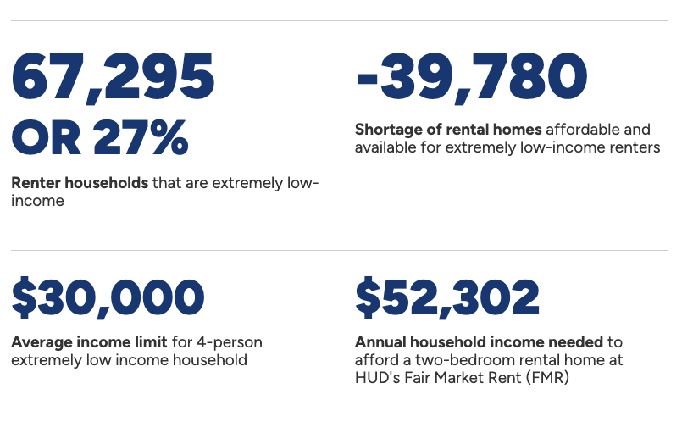
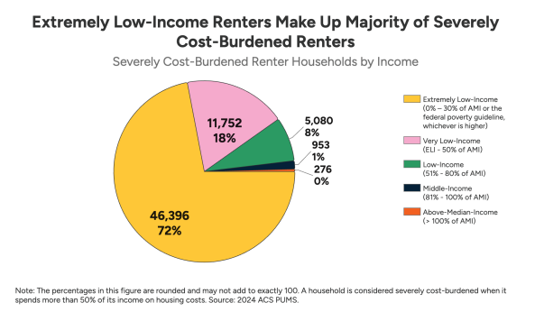
Research on Housing Needs in NM

Slide 11

Take Action!
Join Us by: ​
Emailing or calling your Member's offices to provide the highest possible funding for HUD’s affordable housing, homelessness, and community development programs.
Sharing stories of those directly impacted by homelessness and housing instability.
Join our organizational sign-on letter calling for the highest possible funding for HUD and USDA affordable housing, homelessness and, community development programs in any final FY27 spending bills.
SCAN HERE

Slide 12
Other Ways to Engage
How else can we advance forward?

Slide 13
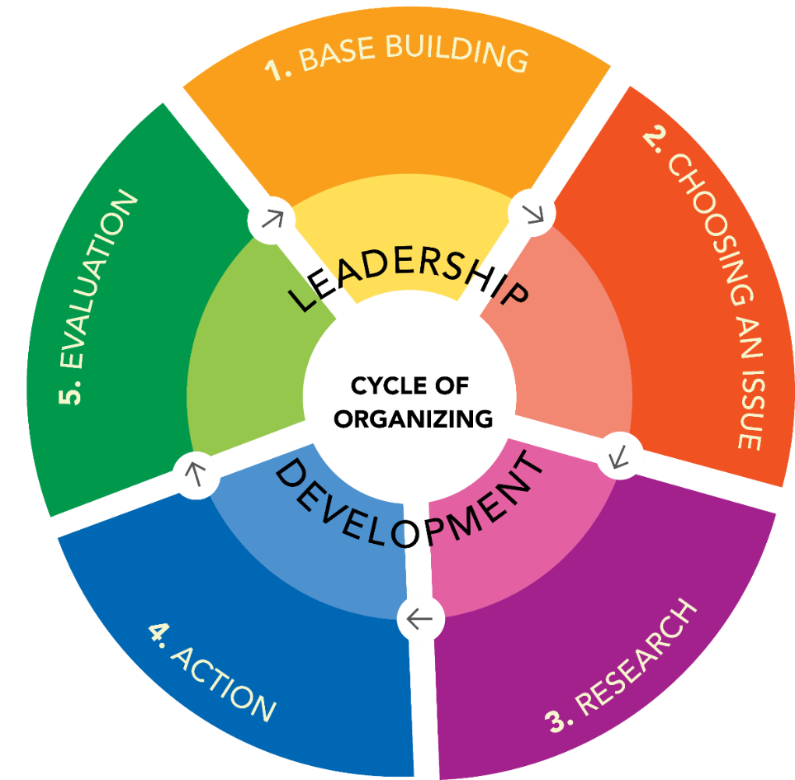
Power-Building Work at NLIHC
Support through:
Organizing Trainings
Capacity-Building
Technical Assistance
Thought Partnership
Notes:
Activation is two-fold. On one hand, there's advocacy which includes the following
Now advocacy is important because like I mentioned earlier with the FY26 budget, when we flood officials with our voice, improvements can be made. However, our voices alone is not always enough as much as we want it to be. That's where people power and pressure comes into play.

Slide 14
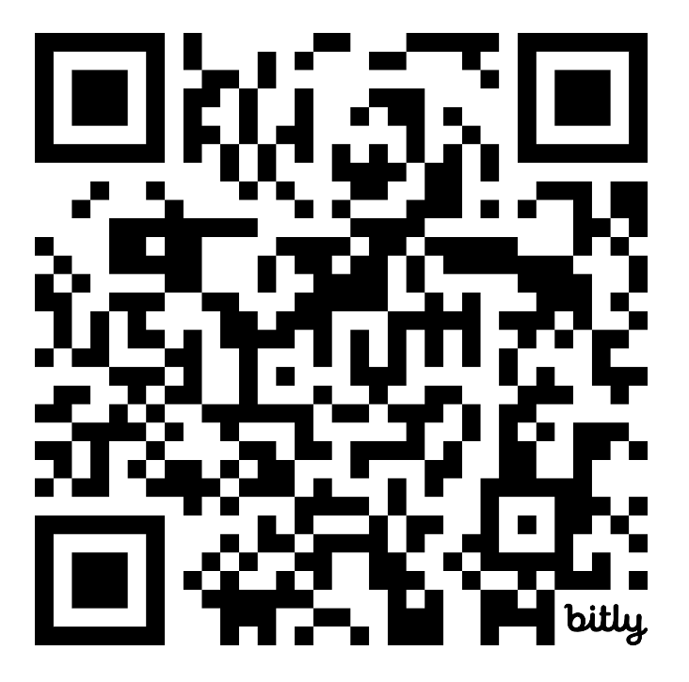
Stay Connected
Join bi-weekly webinars for federal policy updates
Sign-up for newsletters and action alerts
Download research reports and factsheets (The Gap 2026 released March 5th!)
Follow @NLIHC on social media
Join as a member – dues are pay what you want!
Reach out anytime: Kenza Janati (kjanati@nlihc.org)
240-396-9505 x817
nlihc.org/membership

